Slide 1

FINAL YEAR PROJECT “Data Concealment using LSB substitution techniques”
TEAM |  | FACULTY
Mr. Gaurav Walia | Mr. Himalaya Monga | Mr. Sanjiv Kumar Tomar
E.No.: A2305208370 Class - 8CS3 | E.No. : A2305208372 Class – 8CS3 | Senior Lecturer
B.Tech (CS&E) 08-12 | B.Tech (CS&E) 08-12 | ASET, AUUP

Slide 2
Explanation of the Project Title:
We aim to create a secure data sharing system with the intent of cross sharing of data of multiple file type in a hidden shell. This is the process of data concealment.
We have used the techniques of LSB substitution, wherein the input data file’s attributes are put in the output data file, replacing it’s Least Significant Bits.

Slide 3
Application Features
FEATURES OF THE APPLICATION:
Concealing Plain text in an Image File.
Concealing Plain text in an Audio FIle.
Concealing Plain text in a Video File. (NEW)
Concealing Image in an Image File.
Concealing Image in an Audio File.
Concealing Image in a Video File. (NEW)
Concealing Audio in an Image File.
Concealing Audio in an Audio File.
Concealing Audio in a Video File. (NEW)
Concealing Video in an Image File. (NEW)
Concealing Video in an Audio File. (NEW)
Concealing Video in a Video File. (NEW)
ADDED FEATURES:
Dynamic File Compression
Password Encryption for compressed files

Slide 4
Implementation so far :
Implementation as per the project goal, has been completed!
Concealment of all types of files (Plain text, image, audio & video)
All modules of Concealment are finished

Slide 5
Product Functions:
The software will perform following functions:
Password protection of message
Password protection of file
Compression of message
Compression of file
Password protection and compression of message/ File
Embedding all above into an image, audio and video

Slide 6
Basic Flow Chart
IMAGE
MESSAGE
Get_byte_data(image)
[Writable Raster]
Text.getBytes()
Bit Conversion
ENCODE
image=(byte)[(image[offset] & oxfe) | b ]
b= [message >>> bit] & 1
RETURN IMAGE

Slide 7
Internal Mechanism
Input Text | ‘g’ ‘a’ ‘u’ ‘r’ ‘a’ ‘v’
 | 0 1 1 0 0 1 1 1
Image | 1 0 1 0 1 0 1 1 (Original Pixel)
Msg>>>bit | _ _ _ _ _ _ _ 0 + 1
New Image | 1 0 1 0 1 0 1 0 (New Pixel)

Slide 8
COMPRESSION
Firt we initialize the ByteArrayOutputStream class and then we pass the object to ZipOutputStream class. this is how we achieve the main object (for instance zOut).
ByteArrayOutputStream arrayOutputStream= new ByteArrayOutputStream();
ZipOutputStream zOut= new ZipOutputStream(arrayOutputStream);
Passing the file in the ZipEntry constructor and setting the compresssion level
ZipEntry entry= new ZipEntry(dataFile.getName());
zOut.setLevel(compression);
zOut.putNextEntry(entry);
zOut.write(fileArray, 0, messageSize);

Slide 9
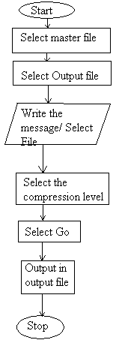
COMPRESSION ONLY

Slide 10
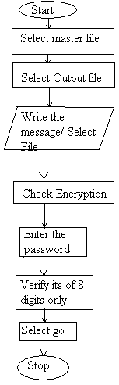
ENCRYPTION ONLY

Slide 11
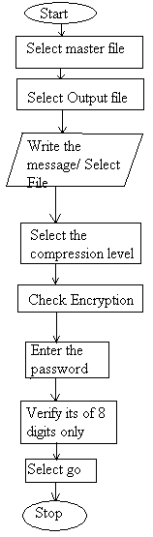
COMPRESSION WITH ENCRYPTION

Slide 12
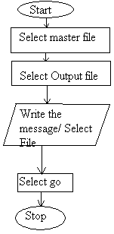
W/O COMPRESSION & W/O ENCRYPTION

Slide 13
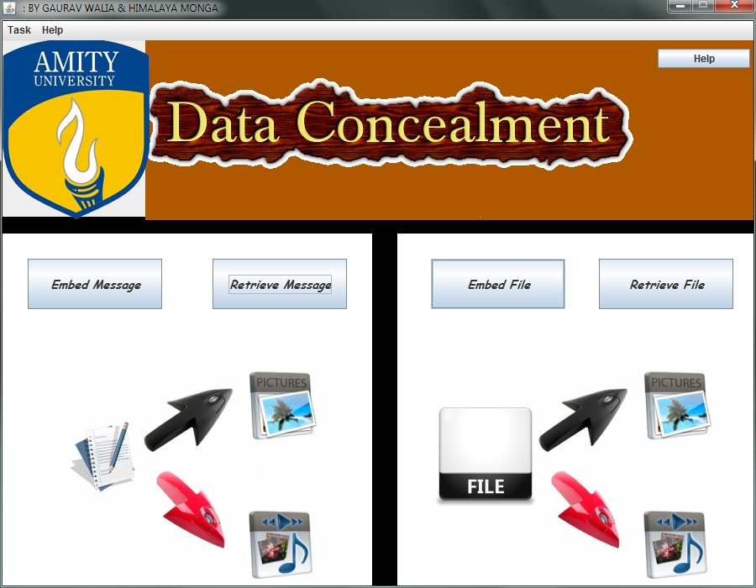
SNAPSHOT : Main Menu

Slide 14
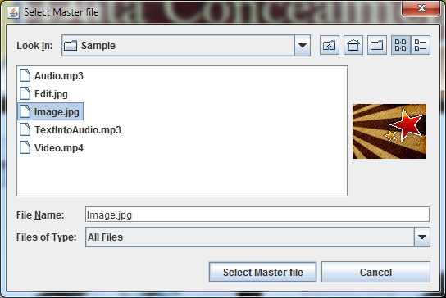
SNAPSHOT: Master File Selection

Slide 15
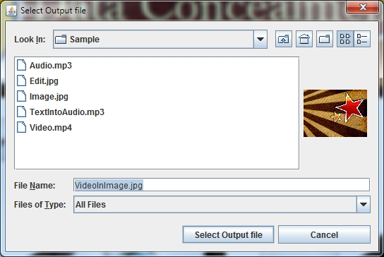
SNAPSHOT: Selecting the new output file

Slide 16
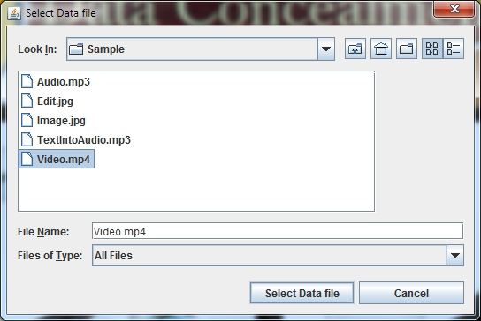
SNAPSHOT: Input File Selection

Slide 17
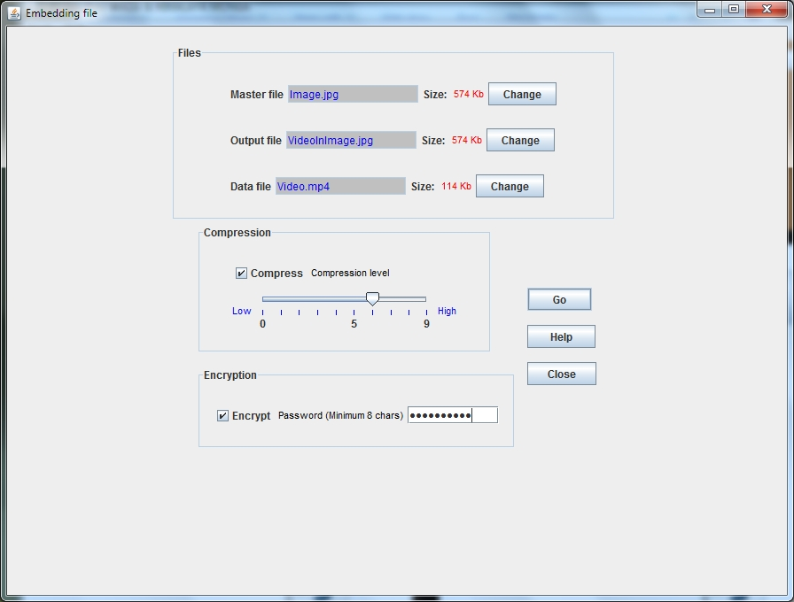
SNAPSHOT: Compression level selection and Encryption choice

Slide 18
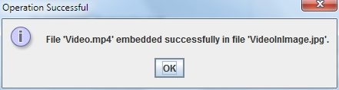
SNAPSHOT: Success Pop up!

Slide 19
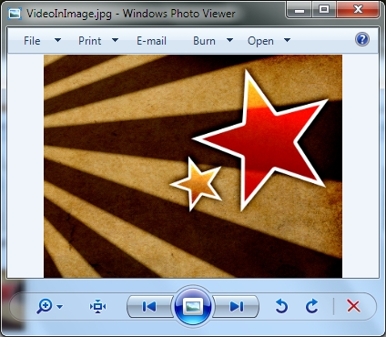
SNAPSHOT: Image still working even after a video hidden!

Slide 20
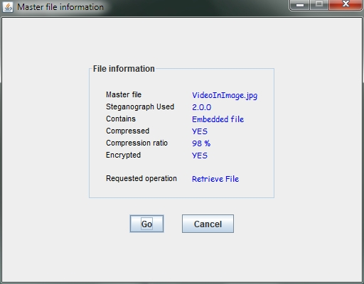
SNAPSHOT: Retrieval – Shows file info

Slide 21
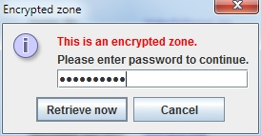
SNAPSHOT: Prompts for password authentication

Slide 22
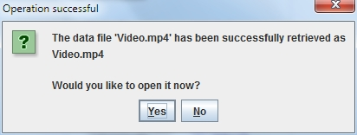
SNAPSHOT: Requests permission for opening of the hidden file!

Slide 23
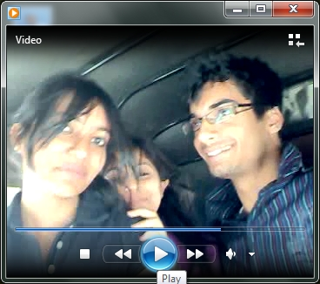
SNAPSHOT: Smooth working of the video, after subsequent embed and retrieval

Slide 24
FUTURE RESEARCH
Other Encryption techniques can also be implemented.
A combination of text and file can also be implemented.
Authentication of user using this software can also be done using passwords for security in the organization.
A more user friendly environment can also be created but that will hamper the system memory requirements.

Slide 25
Thank you.

